Slide 1
Introduction to Multimedia
Integration with hardware

Slide 2
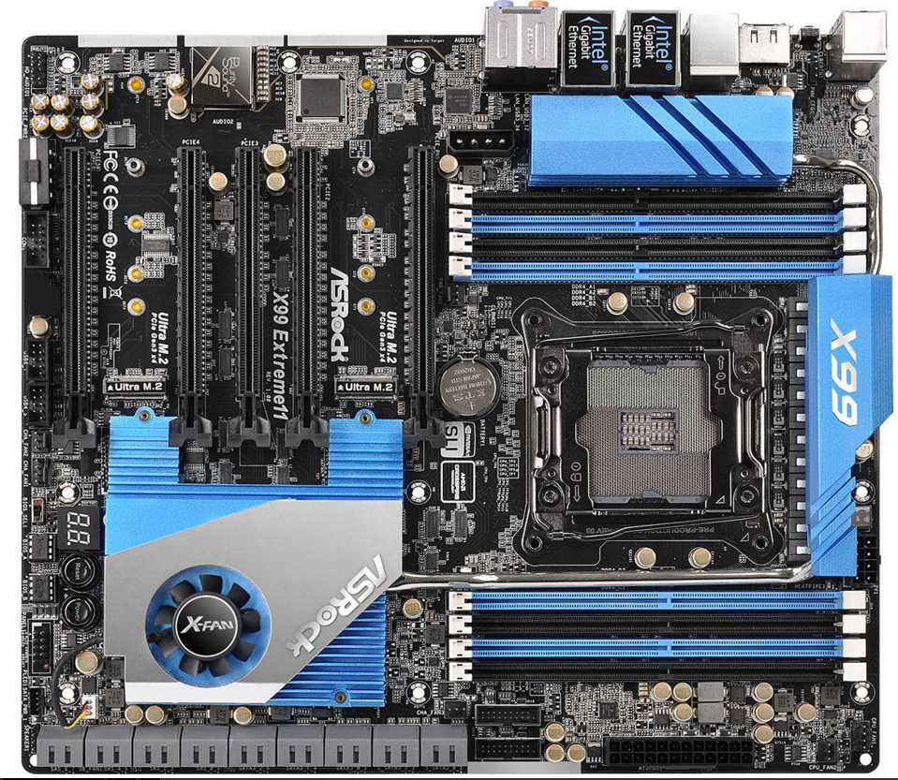
Topology of hardware in a system
North Bridge
GPU
CPU
South Bridge
CPU Memory

Slide 3
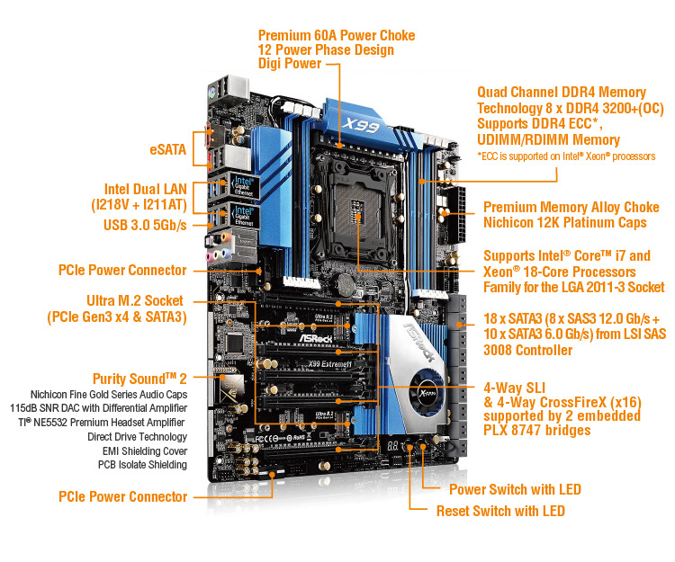
Internal ASICs form a network of chips(Resources)
Video (GPU)
Audio (Audio SOC)
Memory (Memory Controller)
USB (Peripheral Controller)
Network (NIC)
Disk Memory (HDD Controller)

Slide 4
GUI concepts -Resource
Video (GPU)
Audio (Audio SOC)
Memory (Memory Controller)
USB (Peripheral Controller)
Network (NIC)
Disk Memory (HDD Controller)
Resources
GUI Application

Slide 5
GUI Concepts - Sources
After Allocation of resources, the hardware becomes a source for the Graphical Application
Video (GPU)
Memory (Memory Controller)
USB (Peripheral Controller)
Network (NIC)
Disk Memory (HDD Controller)
Source
GUI Application

Slide 6
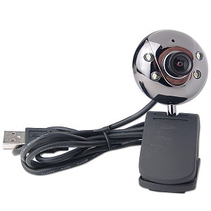
Webcam Example
Camera is controlled over USB
Application Request Video Recording Begins
Camera is enabled as a Resource

Slide 7
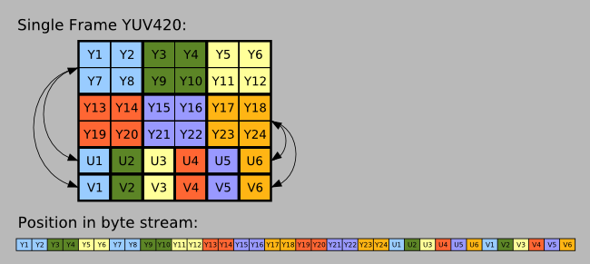
Webcam Example
The Webcam handles the operations of capturing the image without the help of the computer
The image data is stored in an efficient data format

Slide 8

Webcam Example
Camera becomes a source that produces a JPEG image at a negotiated “framerate”.

Slide 9
Webcam Example
Why is the conversion important?
Software Toolkit
The software toolkit likely does not handle YUV format natively. JPEGs and Bitmaps are easier for toolkits to convert to a visual output. (Draw to a framebuffer)

Slide 10
Webcam Example
The toolkit (or driver interface) will then hand the application the data.
More Reading on Camera (Qt/QML)
http://doc.qt.io/qt-5/cameraoverview.html
GUI Application
The application can then decide what to do with image -
Display it
Write it to a file
Send it over a network
Analyze it - OpenCV?

Slide 11
GUI Concepts - Sources
After Allocation of resources, the hardware becomes a source for a Graphical Application
Video (GPU)
Memory (Memory Controller)
USB (Peripheral Controller)
Network (NIC)
Disk Memory (HDD Controller)
Source
GUI Application

Slide 12
GUI Concepts - Sources
Any of these resources could provide a JPEG, or other data set representing a Pixel Buffer
Video (GPU)
Memory (Memory Controller)
USB (Peripheral Controller)
Network (NIC)
Disk Memory (HDD Controller)
Source
GUI Application
In Application code - write to handle a specific type of data but allow for multiple sources (class hierarchy)

Slide 13
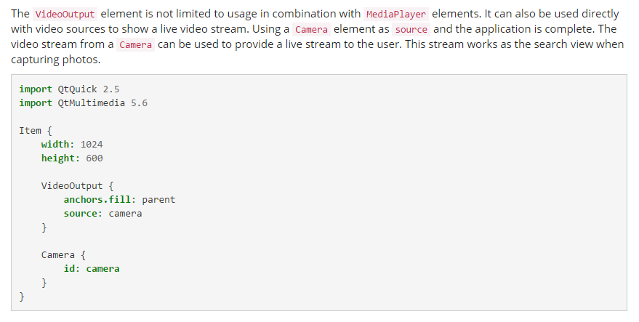
Camera and VideoOutput with Qml
More Reading on Video Output (Qt/Qml)
http://doc.qt.io/qt-5/videooverview.html

Slide 14
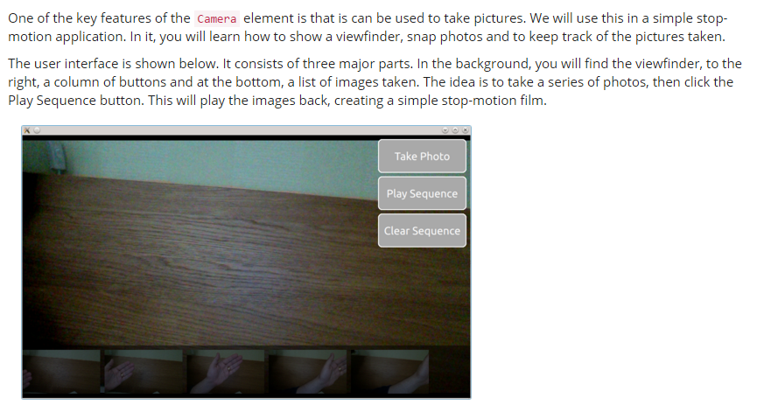
Camera
Still Pictures
Video Preview
Video Record

Slide 15
GUI Concepts - Sound (Load Song)
Hard Disk
Source
GUI Toolkit
Resource
Audio ASIC

Slide 16
GUI Concepts - Sound (Load Song)
Memory (Memory Controller)
USB (Peripheral Controller)
Network (NIC)
Disk Memory (HDD Controller)
Source
GUI Toolkit
Resource
Audio ASIC

Slide 17
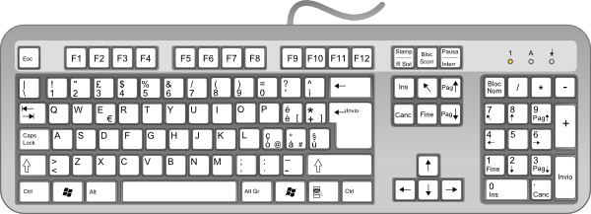
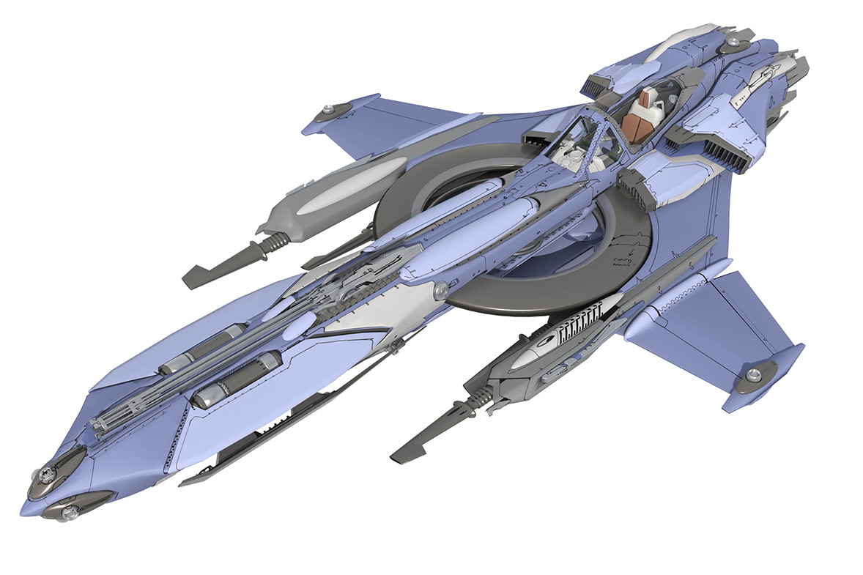
GUI Concepts - Sound (Latency Example)
Events are complex - timing and synchronization is important
Space Key Pressed (Fire)

Slide 18
GUI Concepts - Sound (Latency Example)
Events are complex - timing and synchronization is important
Space Key Pressed (Fire)
Generate laser

Slide 19
GUI Concepts - Sound (Latency Example)
Events are complex - timing and synchronization is important
When to generate sound?
Before or After?
Space Key Pressed (Fire)
Generate laser

Slide 20
GUI Concepts - Sound (Latency Example)
Events are complex - timing and synchronization is important
When to generate sound?
Before or After?
Space Key Pressed (Fire)
Generate laser

Slide 21
GUI Concepts - Sound (Latency Example)
Events are complex - timing and synchronization is important
The user will see before they hear.
(Light travels faster)
Space Key Pressed (Fire)
Generate laser

Slide 22
GUI Concepts - Sound (Latency Example)
Events are complex - timing and synchronization is important
So often the sound needs to start towards the user’s senses before the visual
Space Key Pressed (Fire)
Generate Sound, Generate laser (visual)

Slide 23
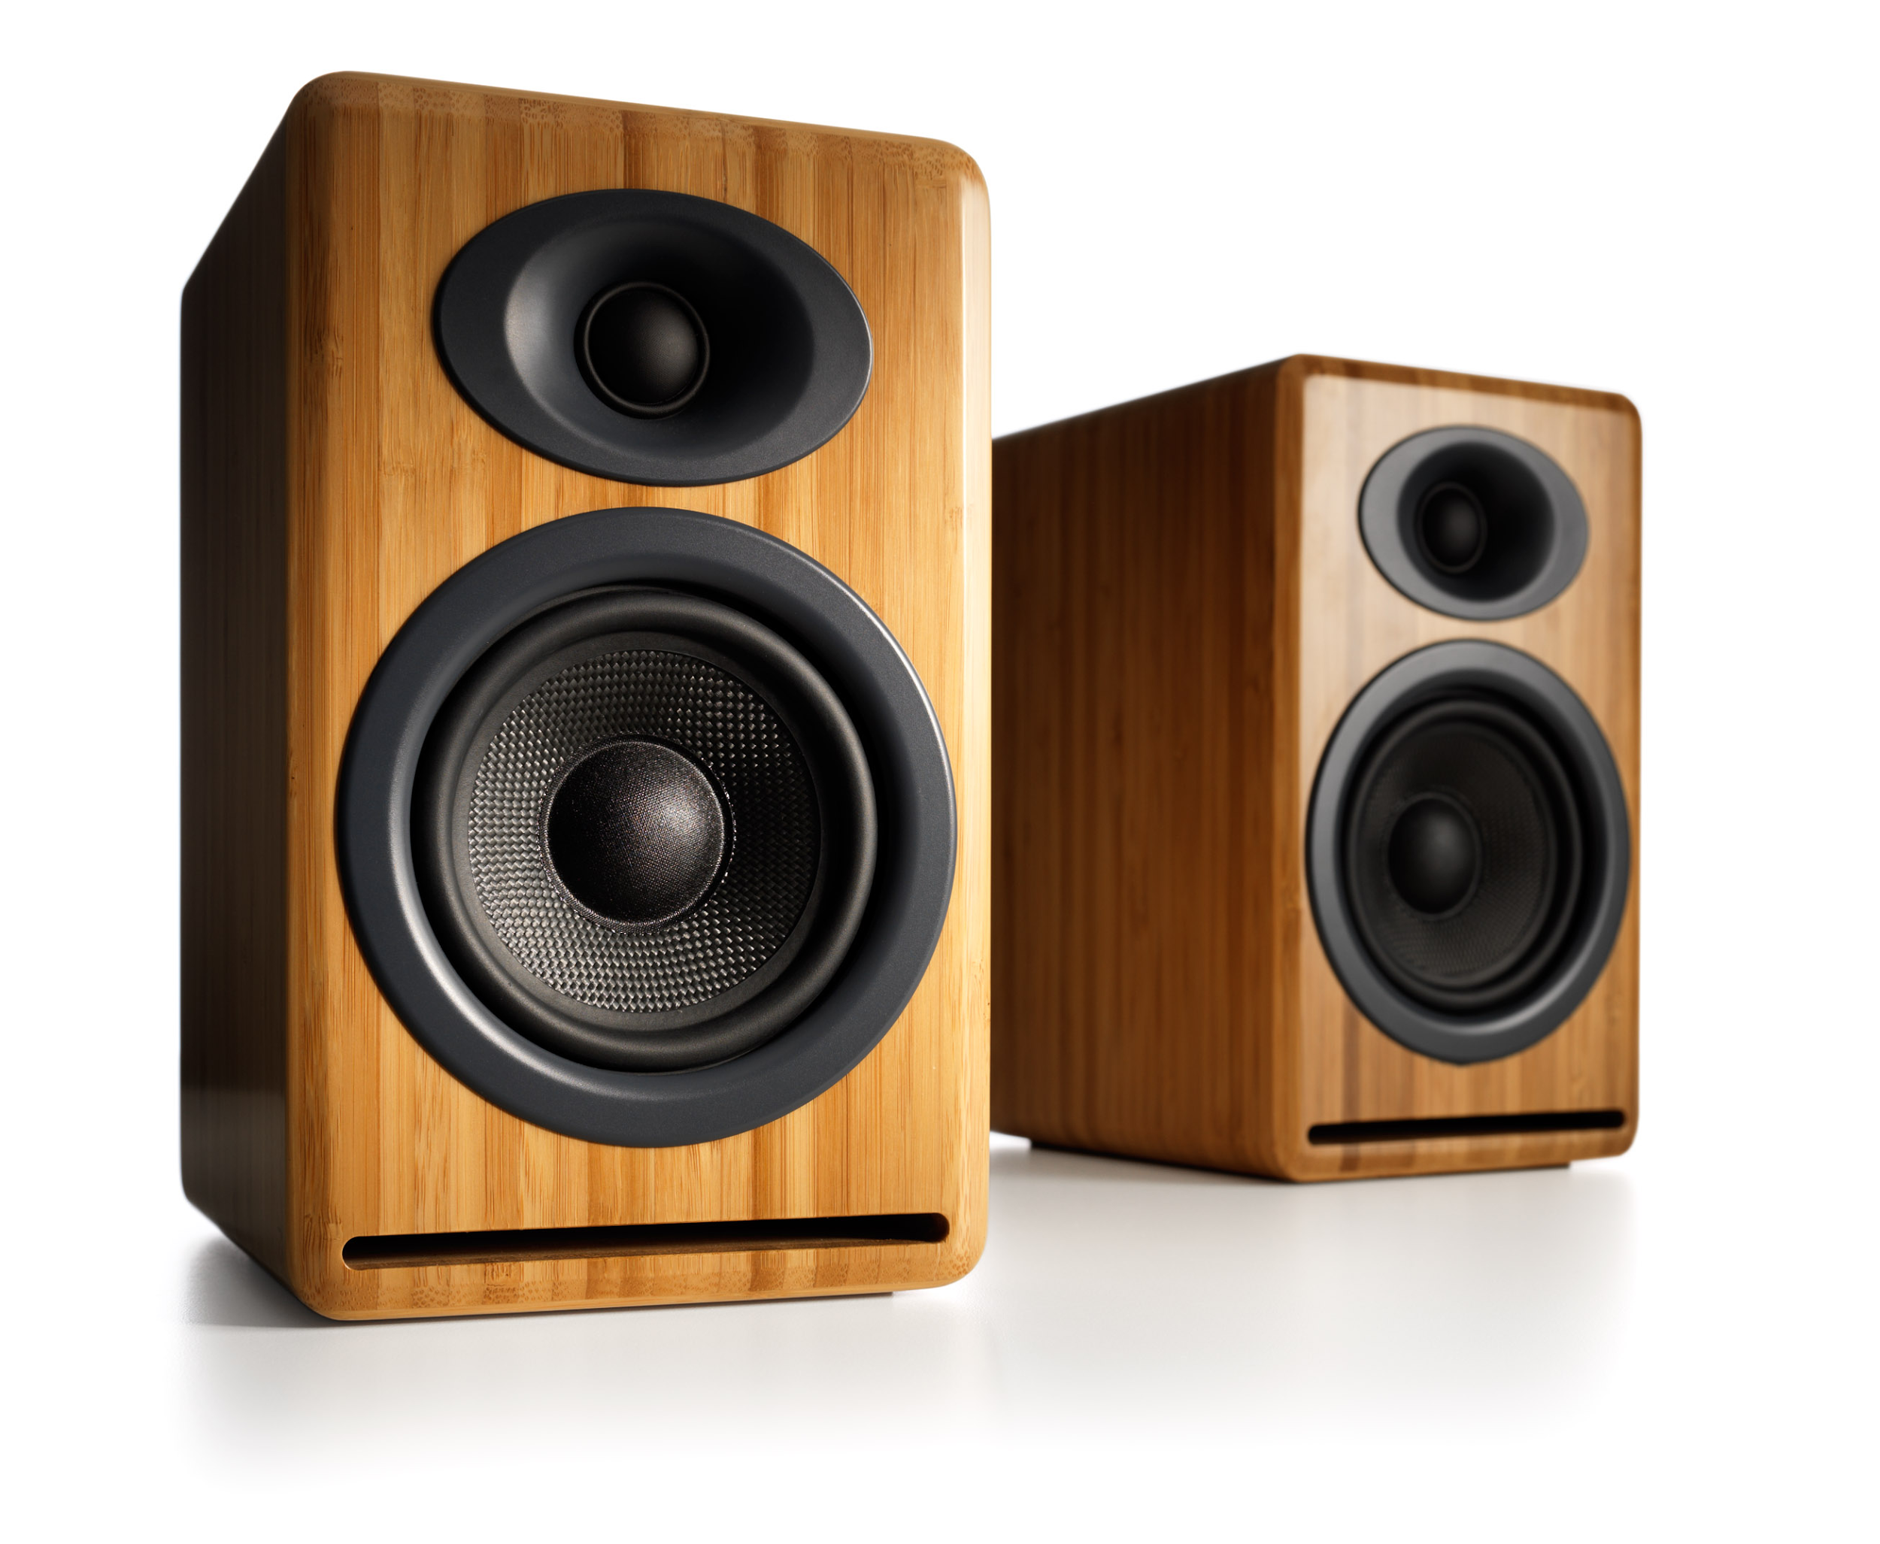
GUI Concepts - Sound (Latency Example)
GUI Toolkit
GUI Toolkit
Resource
Audio ASIC
Audio
D.A.C.

Slide 24
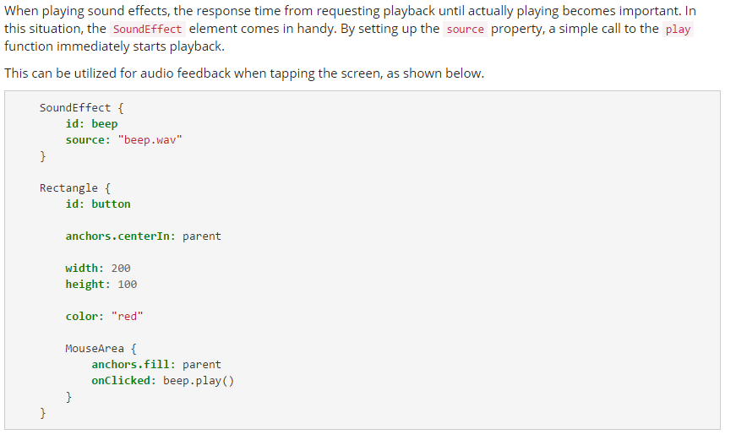

Sound Effect
Produce a low latency sound
QML adds another layer of latency to sound calls. Complex sound operations perform best in C++ with thought put into channel allocation

Slide 25
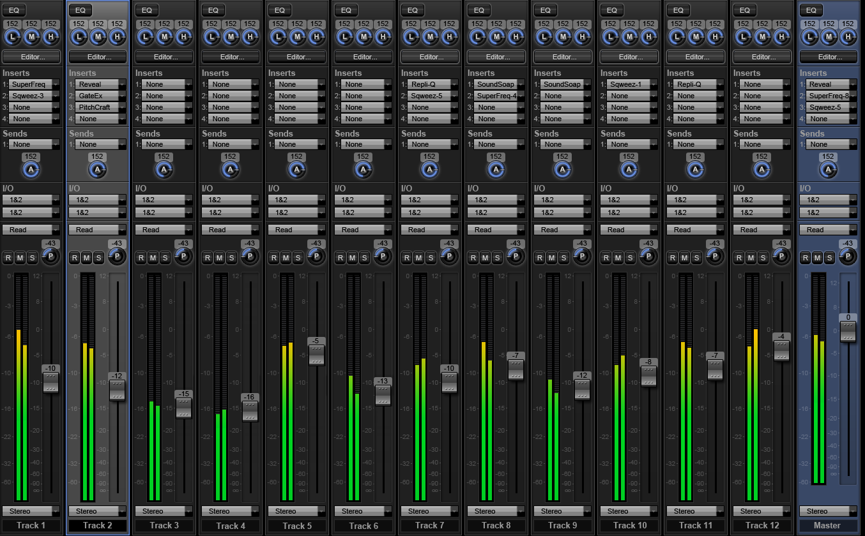
Multiple Channels
Software APIs allow for “Digital Mixing” - using multiple channels
More Reading (Qt/QML): http://doc.qt.io/qt-5/audiooverview.html

Slide 26

Reading This Week:
QML Book (Chapter 10)
http://qmlbook.github.io/en/ch10/index.html
Qt Multimedia
http://doc.qt.io/qt-5/multimediaoverview.html

